Slide 1

The Importance of the Site and Station History Log
Van S Husson
vhusson@peraton.com
ILRS Central Bureau (CB)
ILRS Quality Control Board (QCB)
Networks and Engineering Standing Committee (NESC)

Slide 2
Differences between the Site and Station History Log
ILRS systems are required to keep their site log and station history logs current
The site logs contain
  Detailed system configuration information
  Site location information, system/site identifications, and system eccentricities
  Local site ties to other geodetic techniques
  Points of contact
Station history logs contain system changes, including configuration changes, that could impact data quality
Site log procedure: https://ilrs.cddis.eosdis.nasa.gov/network/site_procedures/site_logs.html
Station history log procedure: https://ilrs.cddis.eosdis.nasa.gov/network/site_procedures/configuration_files.html

Slide 3
The Use of Site Logs and Station History Logs
The primary end user of the site and station history logs is the ILRS Analysis Standing Committee (ASC)
  The system configuration in the site log (i.e. telescope, laser, detector, signal processing, time of flight device, mode of operation, edit criterions) are used to determine the satellite Center of Mass (CoM) corrections
  Entries in the station history log are evaluated by the ASC to determine if they correlate with changes in range bias
Other site log users (e.g. the missions, surveying groups, other geodetic services) may have specific questions and need to know who to contact

Slide 4
Issues with the Site and Station History Logs
Site Log Issues
  Site logs may have inaccurate information and/or may not be current
Station History Log Issues
  Some stations have not provided it
  Some station history logs have large time caps (i.e. few or more years)
  The most frequently asked question about the history log is:
    What type of system changes should be in the station history log?
On the next several slides, we’ll discuss a case study using Graz which will show the value of complete and accurate station history logs

Slide 5
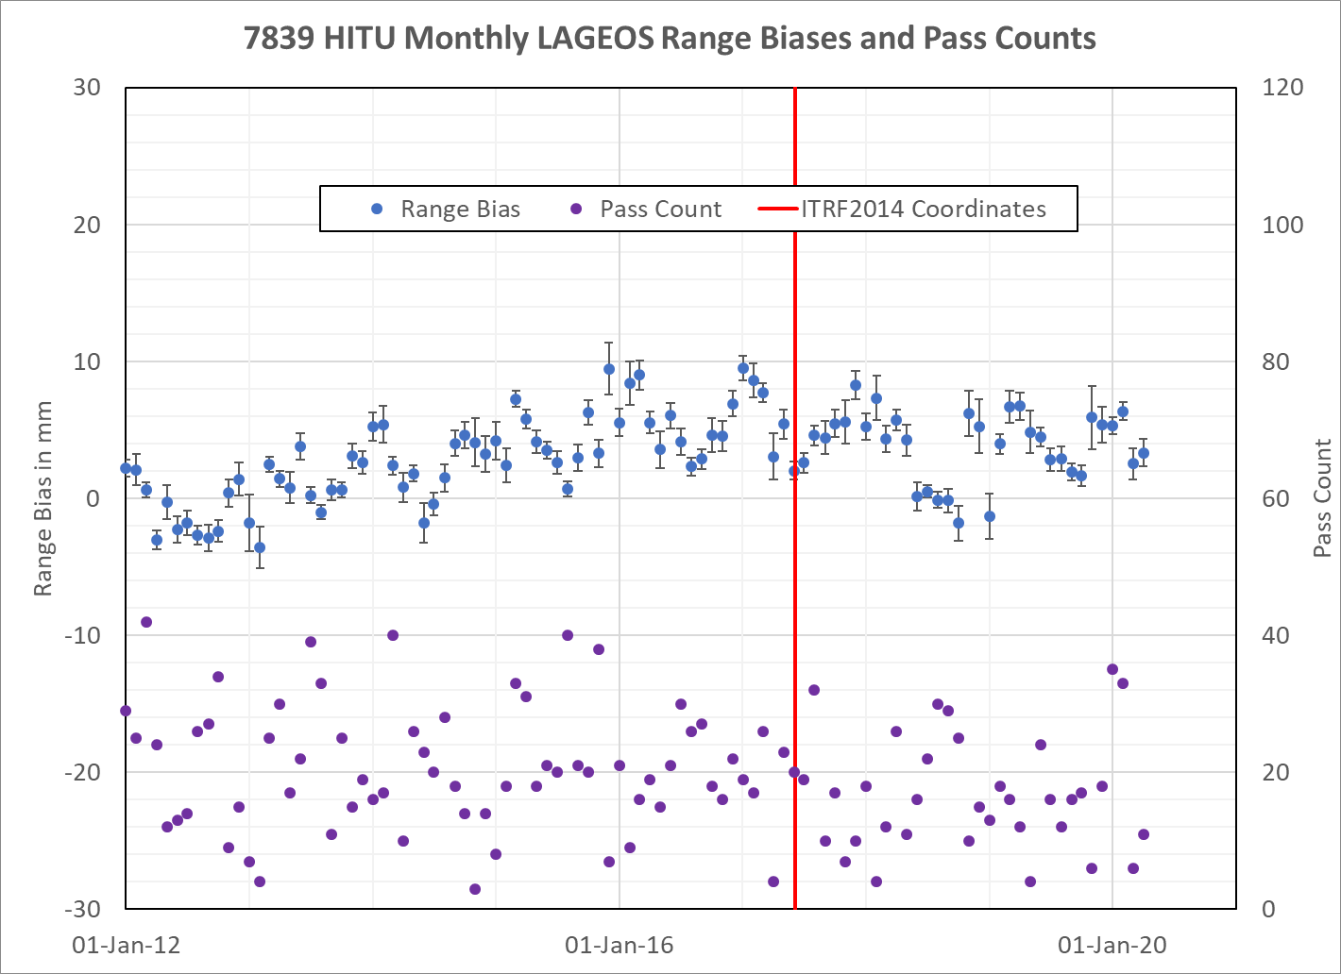
7839 Graz HITU LAGEOS Range Biases
A chart of monthly HITU LAGEOS-1, -2 combined range biases estimates (blue circles) on the left axes and monthly LAGEOS pass counts (purple circles) on the right axes.
HITU updated their station coordinates from ITRF2008 to ITRF2014 in June 2017 (the red vertical line).
These range biases appear out of family. Was this a real range bias change?

Slide 6
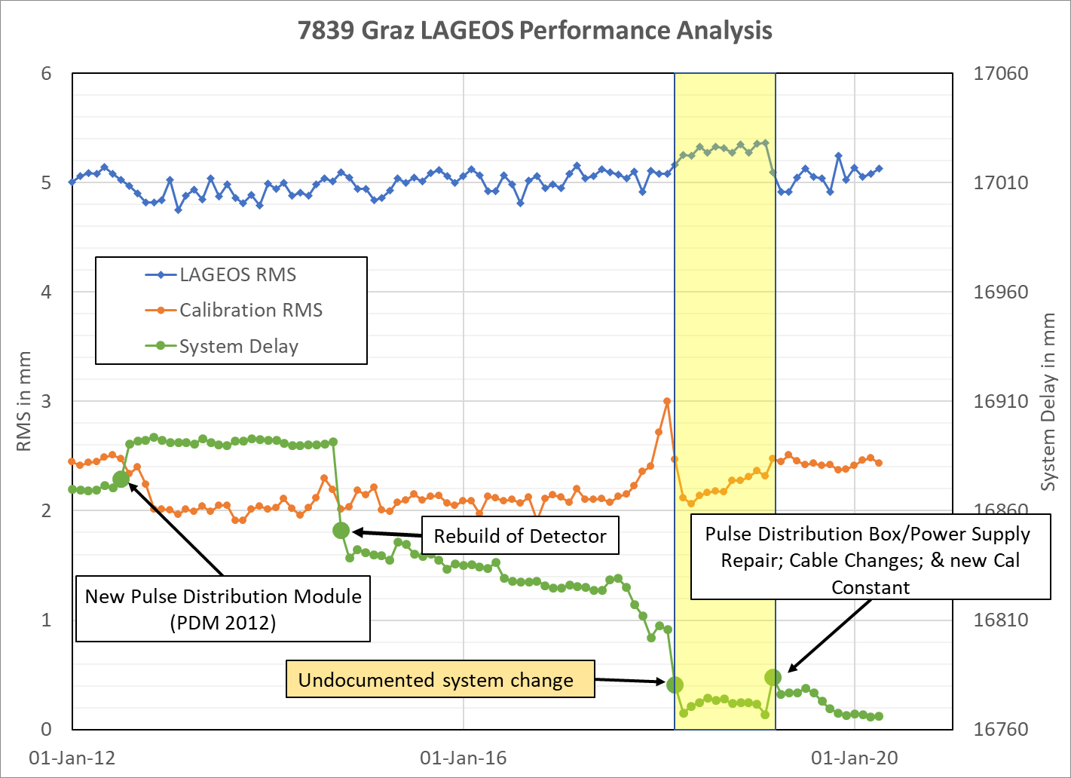
7839 Graz LAGEOS Performance Analysis
This chart represents Graz’s LAGEOS performance with monthly single shot RMSs (satellite and calibration) on the left axis and monthly system delay on the right axis.
Obvious system delay changes are depicted by the large green circles. A system delay change is indicative of a system change.
The highlighted period in pale yellow is between two system changes.
An undocumented change in mid-March 2018 returned calibration RMSs to prior levels.
In May 2020, this chart and the range bias chart from the previous slide were sent to Georg for his input to if there was something noted in the ‘onsite’ logbook in mid-March 2018.

Slide 7
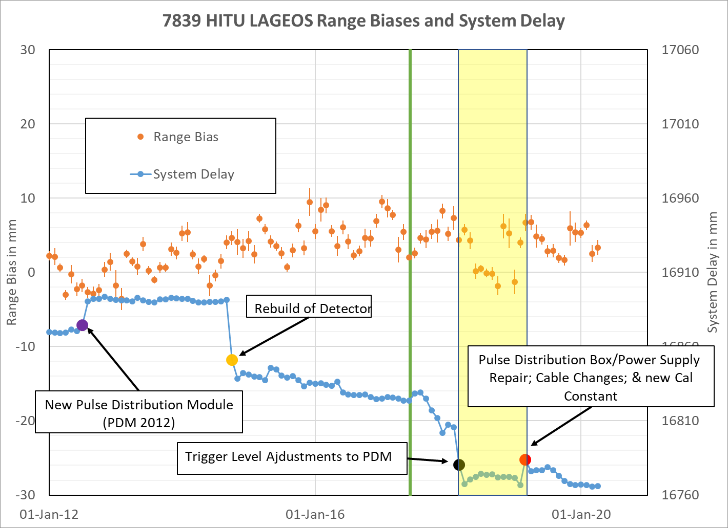
7839 Graz HITU Range Biases and System Delay
Georg revealed that in their internal Graz history log, the PDM trigger levels were adjusted in March 2018.
Here is a chart of the HITU range biases and system delays with the period between the two system changes highlighted in pale yellow.

Slide 8
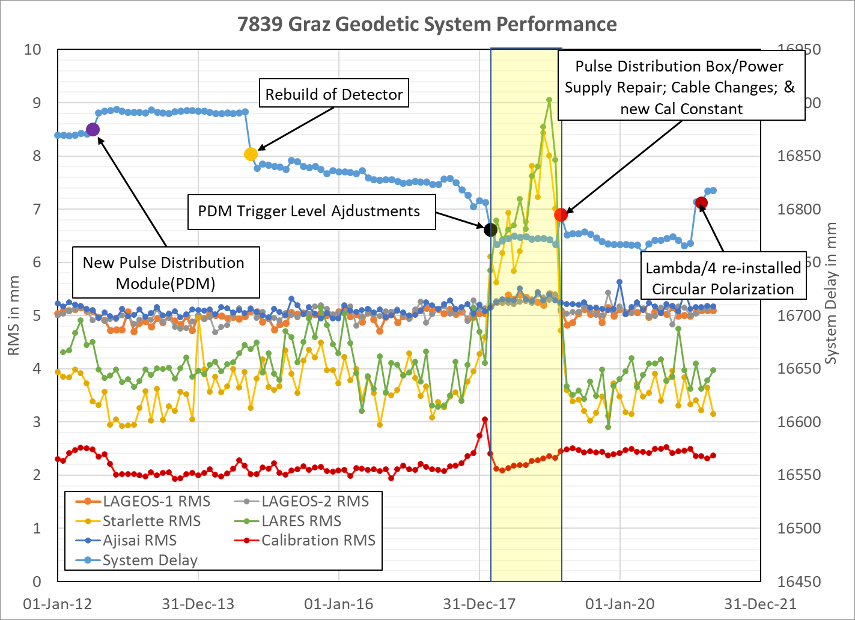
7839 Graz Geodetic Satellite Performance
A time series since 2012 of Graz geodetic single shot RMSs and system delays on the left and right axes; respectively.
The PDM trigger level adjustments in March 2018 (the large black dot on the chart) did return the calibration RMSs to previous levels and stabilized the system delay but the single shot RMSs began to drift until the next system change 12 months later.
Two questions regards to the highlighted area:
  Were there any change in the geodetic range biases relative to each other?
  Why were LAGEOS and Ajisai RMSs less impacted than LARES and Starlette RMSs?

Slide 9
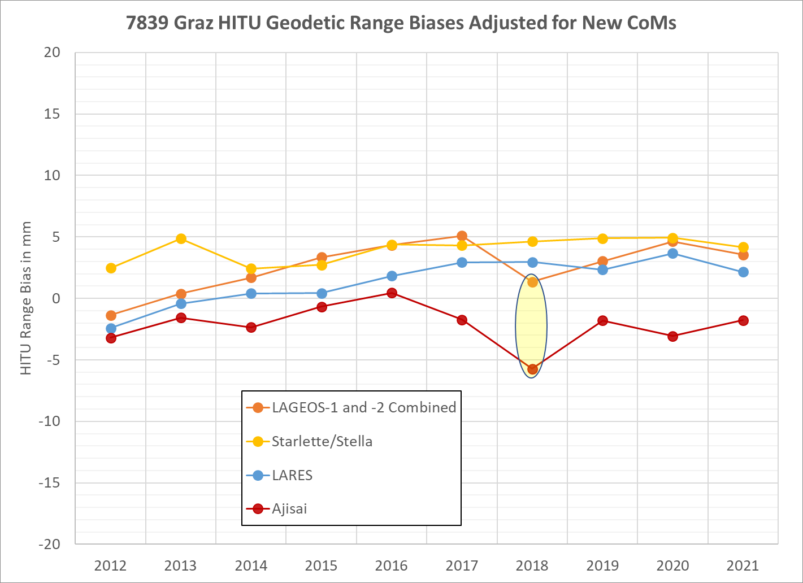
7839 Graz HITU Yearly Geodetic Range Biases
This is a time series of yearly HITU average geodetic range biases adjusted for the latest set of Center of Mass (CoM) corrections from Jose Rodriguez. Note: 2021 results are only thru September 2021.
HITU implemented ITRF2014 coordinates in June 2017. A change in coordinates will impact the range bias estimated for each satellite equally.
Since 2014, there is a consistent mean 2.0 mm offset between LARES and Starlette/Stella range biases. The peak-to-peak variation is only 1.2 mm. Very impressive.
Relative to Starlette/Stella and LARES range biases; there is a 3 to 4 mm drop in both LAGEOS and Ajisai range biases in 2018.

Slide 10
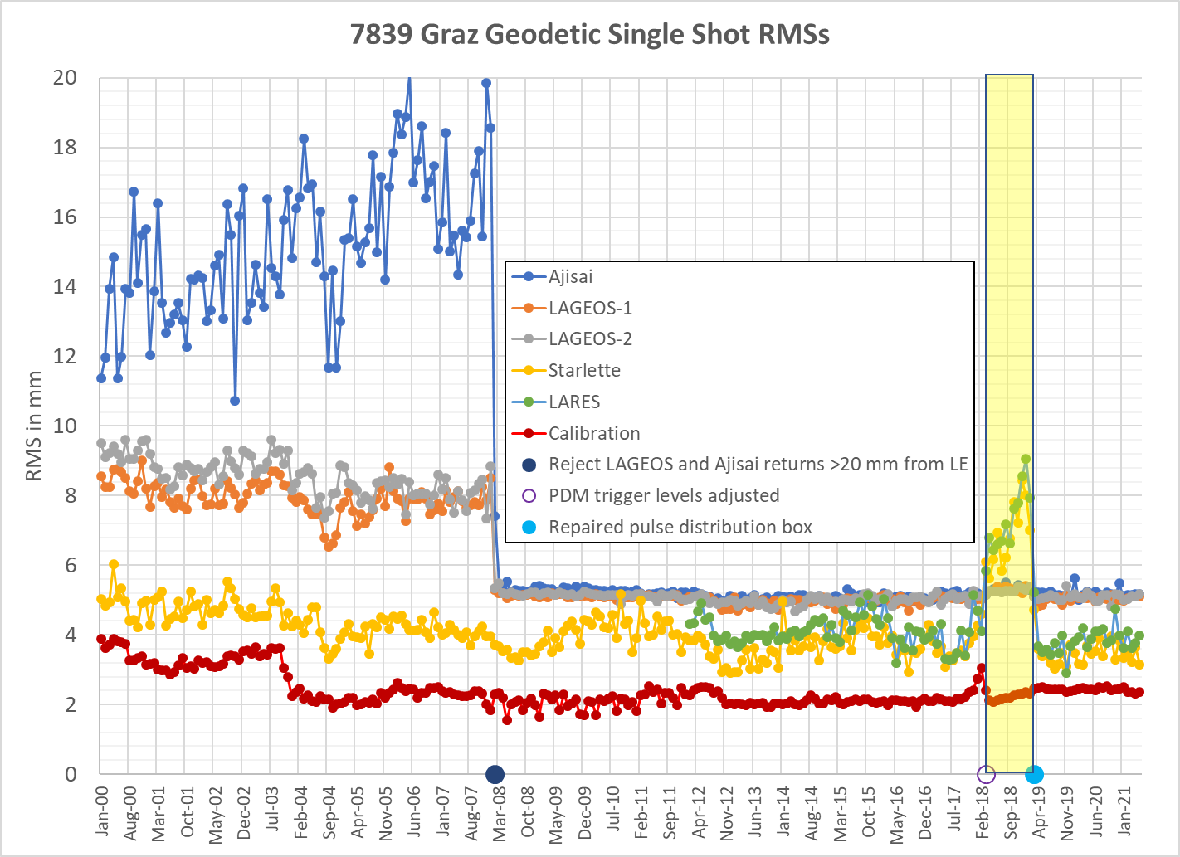
7839 Graz Geodetic Satellite Performance
On 5-Feb-2008, Graz implemented a new data rejection criterion where returns > 20 mm from the Leading Edge (LE) are rejected for LAGEOS-1, -2 and Ajisai [Kirchner et al, 2008, Millimeter Accuracy from Centimeter Targets].
Graz LAGEOS-1, LAGEOS-2 and Ajisai CoM corrections were adjusted by 3.1, 3.4, and 27 mm; respectively.
In mid-March 2018, the PDM trigger levels were adjusted, which stabilized the system delay and returned the calibration RMSs to previous levels. However; for the next 12 months, the RMSs began to increase; a symptom of a hardware issue. LAGEOS and Ajisai RMSs were impacted much less due to the 20 mm LE data editing criteria.
On the 10th of March 2019, the pulse distribution box/power supply was repaired stabilizing the RMSs and returning all RMSs to nominal levels
But more importantly the relative geodetic range bias offsets returned to previous levels and have remained stable since.

Slide 11
Summary/Conclusions/Recommendations
SLR systems are complex and there are many reasons why range biases might change at the mm level, so it is important to report all system changes in the history log. Also keep and maintain detailed internal station logs.
System configuration changes including changes in data editing require both a site and history log update
To answer our original station history log FAQ:
  It is recommended to update the station history log when there is a system configuration change; an equipment change; an equipment adjustment/recalibration; a procedural change; a system performance change; and a data edit criterion change.
This type of system performance analysis may help identify undocumented system changes and these changes in performance may correlate to range bias changes.
Thank you for your attention!

